Slide 1
Iteration 3
Use Case and Prototypes
Team Swiftriver
(Trisia Baltazar, Adrian Boone, Chad Daily, Jann Jalando-on, Mate Kovacs, Joseph Morrison)

Slide 2
Agenda
Current Issues
Example Use Case
Prototypes
Conclusion

Slide 3
Issues
No working donation button
No summer camp sign-ups
Lack of Donor/volunteer registration

Slide 4
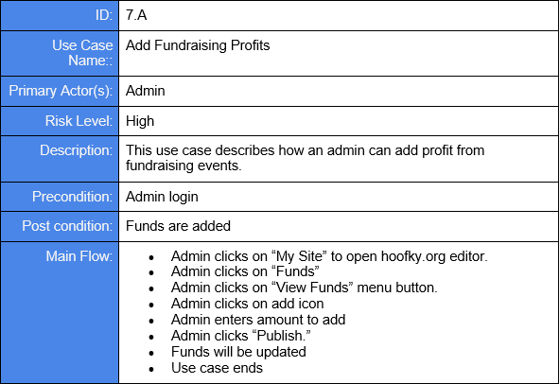
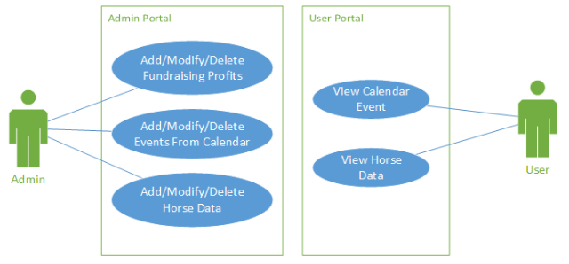
Use Case/ Use Case Diagram

Slide 5
Homepage Prototype
Allows for redirection to all HOOFKY user interactions
Sign-ups
Donations
Events
Social Media

Slide 6
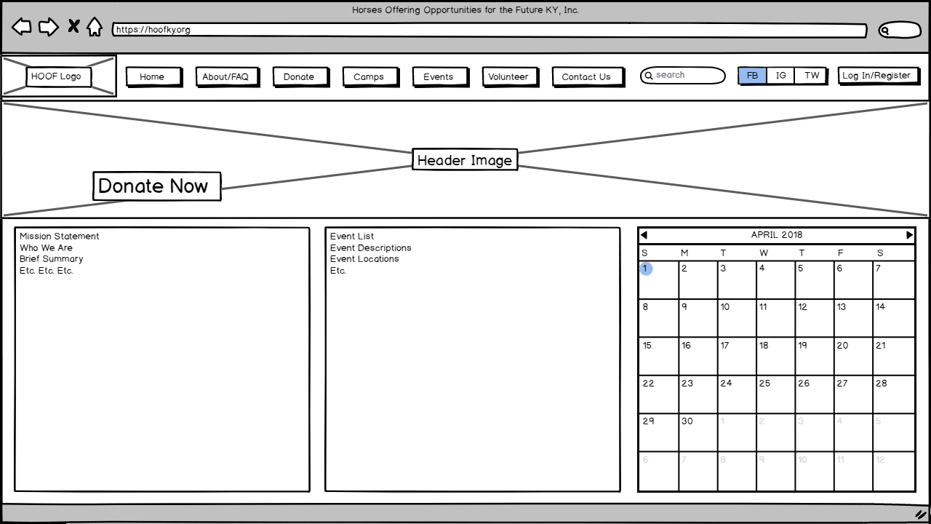

Slide 7
Summer Camp Sign-Up Prototypes
Shows how users can sign up for Summer Camp
User & HOOFKY advantages
Easier Sign Up
Quick application process
Compared to the mailing process
Save information (paperless)

Slide 8
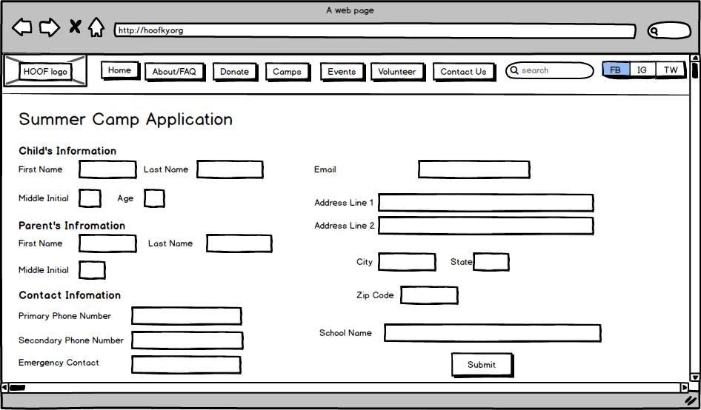

Slide 9
Login/ Register
Shows how to create an account with HOOF
Allows the user to interact with the HOOF website
Volunteer
Donate
Events
Enables HOOF to stay in touch with registered users
News
Events
Camps

Slide 10
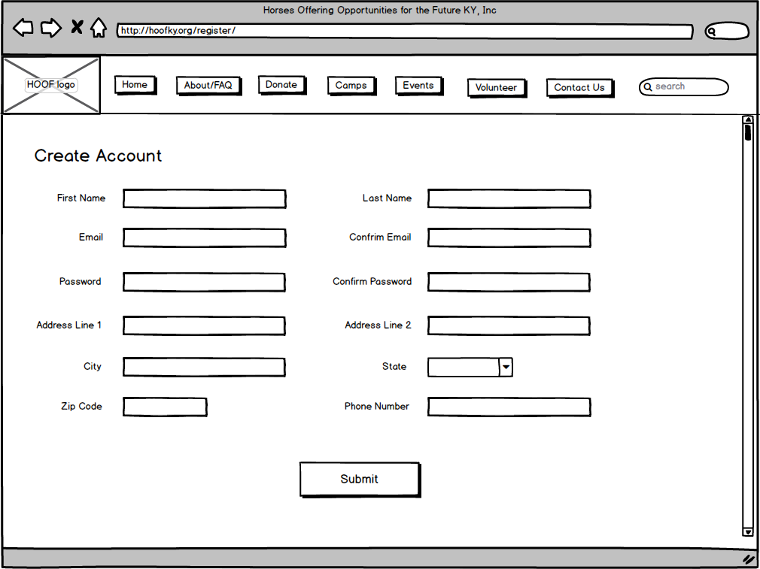

Slide 11
Donation Page
Use Cases
Add One-Time Donation
Add Recurring Donation
Modify Recurring Donation
Delete Recurring Donation

Slide 12
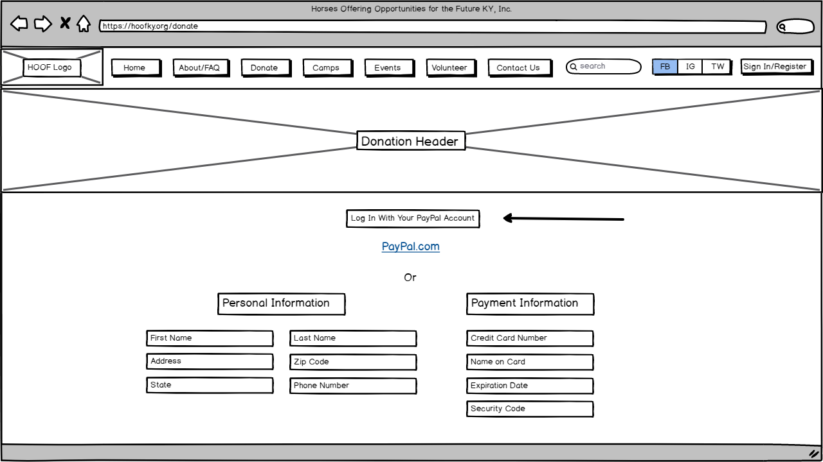

Slide 13
Silent Auction
Use Cases:
Add Silent Auction Sale
This is for recording the sale of a silent auction item.
Modify Silent Auction Sale
This is for modifying a previously recorded silent auction sale.
Delete Silent Auction Sale
This is for deleting a previously recorded silent auction sale.

Slide 14
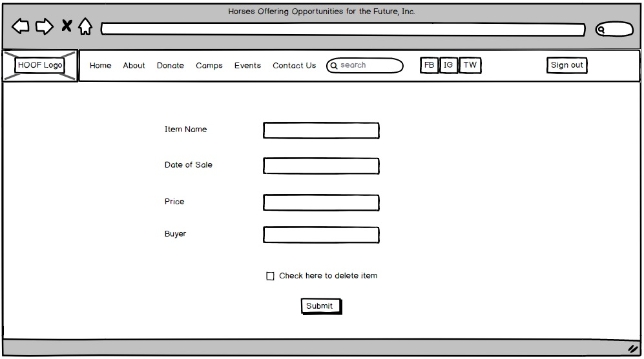

Slide 15
Conclusion
To wrap up, we’ve covered:
Current website issues
Use cases
Prototypes
Any questions?

